Slide 1

Tier-1 proposals
12/01/2021

Slide 2









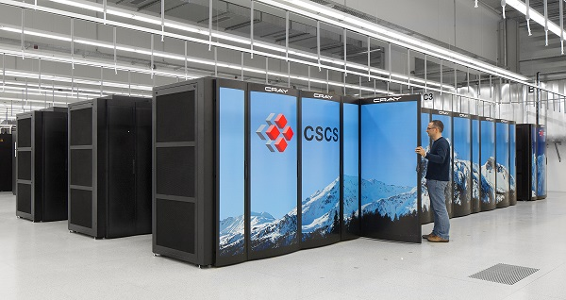

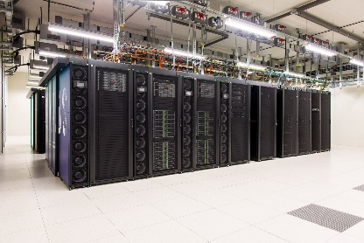





VSC HPC environment
Later this year
Tier-0
Europe
Tier-1
Flanders
BrENIAC
Tier-2
University
STEVIN | HYDRA | LEIBNIZ/Vaughan | GENIUS
2

Slide 3

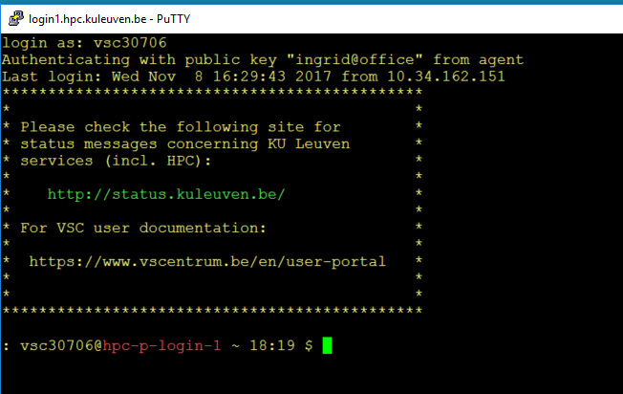

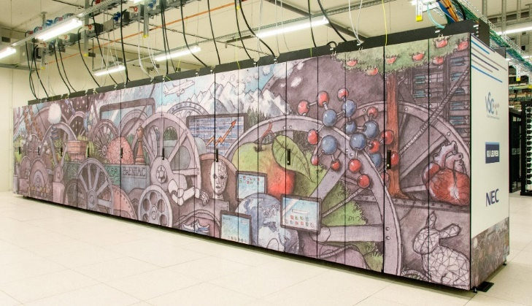


BrENIAC: the fastest supercomputer in Flanders
NX Client
SSH Client
580 nodes – Broadwell
2x Intel E5-2680v4 14c 2.4GHz
128 GB RAM
256 GB RAM
408 nodes – Skylake
2x Intel Gold 6132 14c 2.6GHz
192GB
1.5 TFlop/s peak performance
27664 CPU cores
Infiniband network
Eth network
Check Online VSC doc
GPFS – 1.3 PiB
BW – 20 GB/s
NFS
3

Slide 4
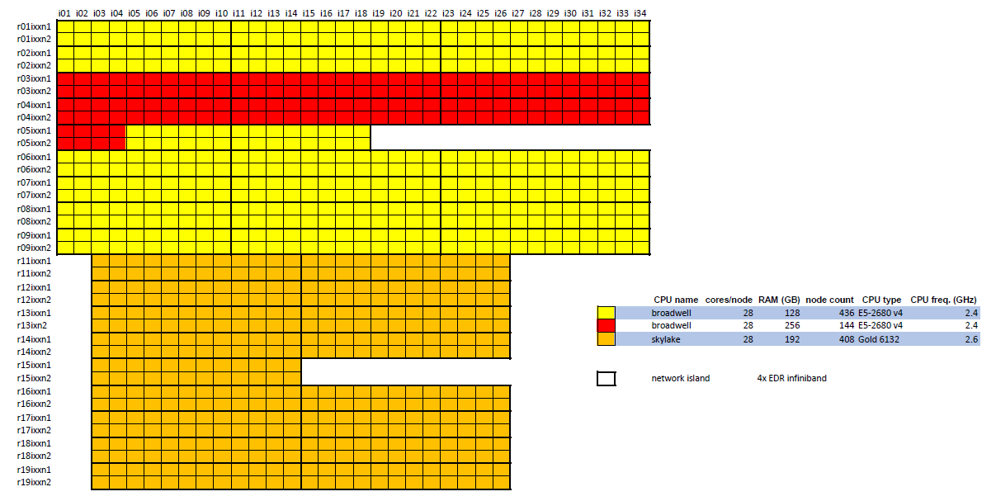
Tier-1 node layout
4

Slide 5
Infiniband network configuration
5

Slide 6
Performance comparison
x1.8
x1.7
CPU bound
Memory bound
6

Slide 7

Tier-1 Hortense update

Slide 8
Tier-1 node specs
 | BrENIAC-Broadwell | BrENIAC-Skylake | Hortense | Hortense GPU
Total nodes | 580 | 408 | 336 | 20
Processor type | Broadwell E5-2680v4 | Skylake Gold 6132 | AMD Rome 7H12 | AMD Rome 7H12
Base Clock Speed | 2.4 GHz | 2.6 GHz | 2.6 GHz | 2.6 GHz
Cores per node | 28 | 28 | 128 | 128
Total cores | 16240 | 11424 | 43008
Memory per node (GB) | 435x128/145x256 | 192 | 294x256 /42x512
Memory per core (GB) | 4.5/9.1 | 6.8 | 2 / 4
Local Disk | 128GB SSD | 480GB SSD
Peak performance (TF) | 623 | 950 | 3300
GPU per node |  |  |  | 4 x nVidia A100-40
Network | Infiniband EDR 2:1 | Infiniband EDR 2:1 | Infiniband HDR-100
8

Slide 9
Tier-1 Hortense – next steps
Installation delayed
Pilot projects will be possible
Machine should become operational in next cutoff period
BrENIAC Skylake will remain operational for 2 more years
9

Slide 10
LUMI – power beyond our Tier-1
Large Unified Modern Infrastructure
Consortium for a pre-exascale machine
As partner Belgium will get access to the machine
Lumi kick-off with specifics about the machine on 14/1
Registration via https://bit.ly/lumi-be-registration.
10

Slide 11
Back to the proposals

Slide 12
Tier-1 proposals – Evolution
12

Slide 13
Regulations 2021 general guidelines
Rules and forms on the VSC-website
Use the 2021 template!
9 sections
Provide all requested information
Respect the length limits of each section
Be consistent in the terminology you use
Federal Funded Research Institutes
Federal Funded Research Institutes
Send us your draft proposal
Feasibility of the proposed tasks
Clearly describe the tasks
Support your target job sizes by scaling tests
Use the resources efficiently
Be clear on how the tasks are managed
Federal Funded Research Institutes
13

Slide 14
Regulations 2021 – Changes
Job sizes now expressed in core-hours (no longer in node-days)
Storage estimates now expressed in TiB (no longer in GiB)
Februari cut-off is only for BrENIAC
NO GPU requests
Federal Funded Research Institutes
Optional request for GPU hours
Collaborative grants
14

Slide 15
Proposal limits
Access
Researchers performing the work | Experienced HPC users
Amount of CPU time
> 500K core-hours | < 5M core-hours, unless justified
Storage
Default: 2TB scratch & 200k files | Describe data management
Duration
8 months | 20% to be used within the first 3 months
System limits
Max 3-day walltime | 128/192/256 GB RAM | Software license
15

Slide 16
Starting grant limits
Request a starting grant on time!
Access
Individual application
Amount of CPU time
500K core-hours
Storage
1TB scratch & 100k files
Duration
4 months
System limits
Same limits as for proposal
16

Slide 17


Tier-1 Allocation Board – TAB
Walter Lioen, chairman (SURFsara, The Netherlands)
Nicole Audiffren (Cines, France)
Gavin Pringle (EPCC, UK)
Isabelle Dupays (IDRIS, France),
Robin Richardson (UCL, IRIS, UK)
Every proposal = independently reviewed by 2 board members
During review meeting, rating is discussed with the full board
The proposal should be self-contained
The full board decides on a final rating
17

Slide 18

Who – Are you eligible?
University or college of higher education
in the Flemish Community
SOC: VIB, Flanders Make, Imec and VITO
Higher education,
such as a special university institution
(Art. 169quater of the Flemish Parliament Act of 12 June 1991)
Research institution under the authority
or supervision of a university or a college
Institution for post-initial education,
support centre for policy-relevant research,
Centre for Research & Development Monitoring
University hospital
(Art. 4 law on hospitals and other care facilities,10 July 2008)
Research institutions of which the activities are entirely or partially financed by the Flemish Community or the Flemish Region
Limited : Federally financed
18

Slide 19
Who – Are you a Tier-1 candidate?
Experience with HPC
Need lots of compute time
Code can run on HPC
Takes too long on Tier-2
Code optimized and scalable
Larger or more complex problems
19

Slide 20
How – Writing a good proposal
Title of research project
Promotor / PI
Needs to proof that it is a scientific validated & financed project
IWETO/FRIS link is recommended
Attach confirmation letter
If project has no scientific approval, letter of the institution
1
Short description: describe the goal of the research
Clear and concise, layman’s terms
Indicate collaboration with other groups
The TAB appreciates well-written descriptions!
2
20

Slide 21
How – make a good proposal
List all users that will use the system
Normally only one proposal per user doing the work
Describe experience of using HPC resources in the past (Tier-0/Tier-1/Tier-2 infrastructure in Belgium and abroad)
Mention previous granted allocations
3
Describe why the work can not be done on Tier-2
Use checkbox
Or
Specify others
4
21

Slide 22
How – make a good proposal
Provide information about software that will be used
specify module name when possible
In case an older software version is used mention specific reason
Provide license / Usage agreement in case of not open source software
5
If a license is needed:
Prove you have a valid license
Prove your license allows to install it on Tier-1
Be sure the license system used can be set on Tier-1
Be sure you have enough licenses for your biggest job
Use a starting grant!
22

Slide 23
How – Writing a good proposal
Efficiency tests, for each software/task
This is the key to a good proposal
Use a starting grant !
Use the template
Use relevant captions/titles
6
Use a starting grant!
Number of nodes | Total number of cores | Wall clock time (s) | Speedup (w.r.t. baseline) | Efficiency
A_{baseline} | B_{baseline} | C_{baseline} | 1.00 | 1.00
A1 | B1 | C1 | C_{baseline}/C1 | (B_{baseline}*C_{baseline})/(B1*C1)
A2 | B2 | C2 | C_{baseline}/C2 | (B_{baseline}*C_{baseline})/(B2*C2)
Baseline = minimal configuration with which your computational task can be carried out on Tier-1.
Wall clock time is difference between start/end of the computational task, including any I/O operations as part of that task.
Number of nodes | Total number of cores | Wall clock time (s) | Speedup (w.r.t. baseline) | Efficiency
1 | 1 | 4000 | 1.00 | 1.00
1 | 7 | 580 | 6.90 | 0.99
1 | 14 | 289 | 13.84 | 0.99
1 | 28 | 146 | 27.40 | 0.98
2 | 56 | 81 | 49.38 | 0.88
4 | 112 | 43 | 93.02 | 0.83
8 | 224 | 23 | 173.91 | 0.78
10 | 280 | 19.8 | 202.02 | 0.72
12 | 336 | 19.7 | 203.05 | 0.60
14 | 392 | 19.4 | 206.19 | 0.53
16 | 448 | 19.2 | 208.33 | 0.47
23

Slide 24
Scaling tips – Representative results
Use a relevant problem size
Model size, geometry, atoms in model
Grid size, with a relevant workload in each cell
Same AMR levels
Use the minimum time of at least 3 separate runs
24

Slide 25
Scaling tips – Hardware
BrENIAC has 2 different CPU types
Be sure to use a specific type in your tests
Initally test on both types to determine which you can use best
Mention the type used in the proposal
Inter-node communication
If timings strongly vary in multi-node jobs, consider using nodes on the same island https://vlaams-supercomputing-centrum-vscdocumentation.readthedocs-hosted.com/en/latest/leuven/breniac_quickstart.html#job-communication-and-network-islands
25

Slide 26
Scaling tips – Hardware
We performed the parallel efficiency tests of our sofware on both architectures of Tier-1 BrENIAC compiled with architecture-specific modules. Our initial experiments showed that the code’s performance on Skylake was 1.8 times faster than on Broadwell, so we have only focused on Skylake for the remaining benchmark tests.
At first the code was run for 72hrs on a single Skylake node and on a single Broadwell node. On the Skylake node the model reached the time 5.568155e9 and on the Broadwell node the time 5.370498e9. This means that on the Skylake node the code runs just 3.7% faster. Therefore, we decided to run the scalability test only on the Broadwell nodes as the codes does not benefit much from the Skylake architecture.
26

Slide 27
Scaling tips – Parallelization options
Consider e.g. hybrid MPI – OpenMP parallelization (if possible)
MPI
27

Slide 28
Scaling tips – What to test
Start with intra-node scaling
Start from smallest core count, preferably single core
Use appropriate timesteps/simulation time to fit in 3-day walltime, do not change the domain size
Run with 1/7/14/28 cores
Then move on to multiple nodes
You can make use of profiling tools
Can help you to see how much time is spend on CPU/MPI/IO
28

Slide 29
Scaling tips – Parallelization schemes
Also investigate other parallelization options provided by the software
Example: Vienna Ab initio Simulation package (VASP)
k-point parallelization: KPAR: number of k-points to be treated in parallel
band parallelization: NPAR: number of electronic bands to be treated in parallel
distribution over plane-waves for cores working on same k-point & band
(Additional tip: “LREAL” flag strongly influences performance and scaling!)
Number of cores | Combinations to test in case of 4 k-points
1 | KPAR=1,NPAR=1
7 | KPAR=1,NPAR=1,7
14 | KPAR=1,NPAR=1,2,7,14 | KPAR=2,NPAR=1,7
28 | KPAR=1,NPAR=1,2,4,7,14,28 | KPAR=2,NPAR=1,2,7,14 | KPAR=4,NPAR=1,7
56 | KPAR=1,NPAR=1,2,4,7,14,28 | KPAR=2,NPAR=1,2,7,14,28 | KPAR=4,NPAR=1,2,7,14
29

Slide 30
Scaling tips – High-throughput computing (HTC)
Test scaling in the node
If multi-core is loosing efficiency, stick to single core
Test timing with a single work item on a single node
Test timing with 28 work items on a single node to check if there are bottlenecks (eg I/O or memory)
Explain workload management, use worker framework
https://vlaams-supercomputing-centrum-vscdocumentation.readthedocs-hosted.com/en/latest/jobs/worker_framework.html
30

Slide 31
Scaling tips – Presenting the results
Use the template tables
Use appropriate titles and captions
Explain anomalies in plot and table
Explain chosen job size
Make sure that you have a data point for the chosen job size
31

Slide 32
Example table
Table1: Scalability test for my software on Skylake CPUS, using 32 x 32 x 32 grid cells with 7 levels of refinement (333,824 grid cells in total)
Figure 1: Parallel efficiencies for my software on Skylake CPUS 32 x 32 x 32 grid cells with 7 levels of refinement (333,824 grid cells in total)
Remarks ?
If you would take 6 nodes (168 cores) as your preferred size, also include timing results for 6 nodes
32

Slide 33
Example table
33

Slide 34
How – Writing a good proposal
Justify the requested number of core-hours, based on scaling tests in (6)
Break down the work as much as possible
Describe well each step and the resources needed, in table and text
Describe scratch space usage if you run tasks concurrently
7
 | Core-hour calculation |  |  |  |  |  |  | Storage volume estimate
Computational task | Number of such jobs | Wall clock time (in hours) per job | Number of Tier-1 nodes per job | Number of Tier-1 cores per job (per node!) | Total core -hours per task | Memory usage (GiB) per node per job | OpenMP / MPI / OpenMP + MPI (hybrid) / worker framework / atools / etc. | Tier-2 DATA/HOME volume (TiB) + number of files | Tier-1 SCRATCH volume (TiB) + number of files
Task1 | A | B | C | D | A x B x C x D
34

Slide 35
How – Core-hour calculations
 | Core-hour calculation |  |  |  |  |  |  | Storage volume estimate
Computational task | Number of such jobs | Wall clock time (in hours) per job | Number of Tier-1 nodes per job | Number of Tier-1 cores per job (per node!) | Total core-hours per task | Memory usage (GiB) per node per job | OpenMP / MPI / hybrid / worker framework | Tier-2 DATA/HOME volume (TiB) + number of files | Tier-1 SCRATCH volume (TiB) + number of files
Task A CP2K – molecular dynamics 50 ns runs PBE functional 1 -> 5 water molecules | A | B | C | D | A x B x C x D
 |  |  |  |  | Sum of core-hours applied for = .. |  |  |  | Largest amount of scratch disk required + number of associated files = ..
Important information
 |  | 3 days is the maximal wall clock time for any job. |  |  |  | Memory limits (GiB/CPU node) BrENIAC: 128->256 Hortense: 256->512
Check the math!
35

Slide 36
How – Core-hour calculations
 | Core-hour calculation |  |  |  |  |  |  | Storage volume estimate
Computational task | Number of such jobs | Wall clock time (in hours) per job | Number of Tier-1 nodes per job | Number of Tier-1 cores per job (per node!) | Total core-hours per task | Memory usage (GiB) per node per job | OpenMP / MPI / hybrid / worker framework | Tier-2 DATA/HOME volume (TiB) + number of files | Tier-1 SCRATCH volume (TiB) + number of files
Task A CP2K – molecular dynamics 50 ns runs PBE functional 1 -> 5 water molecules | 30 | 48 | 10 | 28 | 403200 | 64 | MPI | 0 TiB 0 files | 0.2 TiB 5000 files
Task B CP2K – molecular dynamics 100 ns runs PBE functional 1 -> 5 water molecules | 5 | 72 | 20 | 28 | 201600 | 64 | MPI | 0 TiB 0 files | 0.1 TiB 500 files
 |  |  |  |  | 604800 |  |  |  | 0.2 TiB 5000 files
36

Slide 37
How – Core-hour calculations (HTC)
 | Core-hour calculation |  |  |  |  |  |  | Storage volume estimate
Computational task | Number of such jobs | Wall clock time (in hours) per job | Number of Tier-1 nodes per job | Number of Tier-1 cores per job (per node!) | Total core-hours per task | Memory usage (GiB) per node per job | OpenMP / MPI / hybrid / worker framework | Tier-2 DATA/HOME volume (TiB) + number of files | Tier-1 SCRATCH volume (TiB) + number of files
Task example worker MDTraj post-processing 5000 files | 10000 | 0.5 | 1 | 1 | 5000 | 3 (84 GiB for 28 jobs in one node) | These single-core jobs will be packed within 1 node using worker framework | 1 TiB 10000 files | 0.1 TiB 5000 files
Assuming you can indeed run 28 tasks on a single node!
Running fewer tasks per node may be necessary in certain cases (e.g. insufficient memory).
Your number of cores per job will then be > 1.
37

Slide 38
How – Writing a good proposal
Describe your workflow
usage pattern/timing
task workflow manager
how you organize in and outflow of data
Don’t forget – allocated time should be used in 8 months
20 % used on the first 3 months!
8
9
If your application is exemplary, can it be used as an example ?
38

Slide 39

How – Writing a good proposal
Proposals are submitted in EasyChair
You can submit only 1 file
Combine your proposal with attachments in 1 PDF file
39

Slide 40

How – Using the allocated grant
Be ready to start working as soon as you are granted
Do not wait until the end of the period
Use all the granted time
If applied for a “Starting Grant” -> use it!
It is going to be checked by the TAB
Extensions are not granted (unless for a very good reason)
40

Slide 41
Collaborative Grants

Slide 42
Collaborative Grant
Rules and form on the VSC-website
At least 3 research groups from different instututes
Federal Funded Research Institutes
Inform us if you are interested
Application has the same structure as a regular proposal
Federal Funded Research Institutes
Allocation at any time
Review by Operation Team
Federal Funded Research Institutes
42

Slide 43
Proposal limits
Access
Experienced HPC users
Collaborations between research groups/institutes
Amount of CPU time
> Max 10M core-hours
Duration
12 months
System limits
Max 3-day walltime | 128/192/256 GB RAM | Software license
43

Slide 44
Questions

